Slide 1
Educational system in great britain
Batomunkueva Dulma

Slide 2
PLAN
Primary education in the UK
Types of schools in primary education
Secondary education in the UK
Types of schools in secondary education
Education in the USA
Education in Russia

Slide 3
Levels of education
Education
Primary
Secondary

Slide 4
Primary Education
age
11
10
Junior school
9
8
7
Infant school
6
5

Slide 5
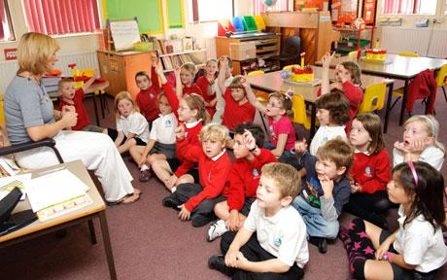
Infant and junior schools
They are usually combined under the roof of one school.

Slide 6
Secondary education
Secondary education
Comprehensive school
Grammar school
Technical school
Modern school

Slide 7
Comprehensive school
Take pupils of all abilities without any exams
Put students into sets
Give wide range of subjects
5 forms
Art
Music
Physical education
Practical works
History
General sciences
Languages
Geography
Religious instructions

Slide 8
Sets
Sets are small groups which formed according to student’s abilities and interests.

Slide 9
Grammar school
Exam called 11+
Grammar school
Good result
Grammar school gave secondary education of a rather high standart.
Bad result
Secondary Modern school

Slide 10
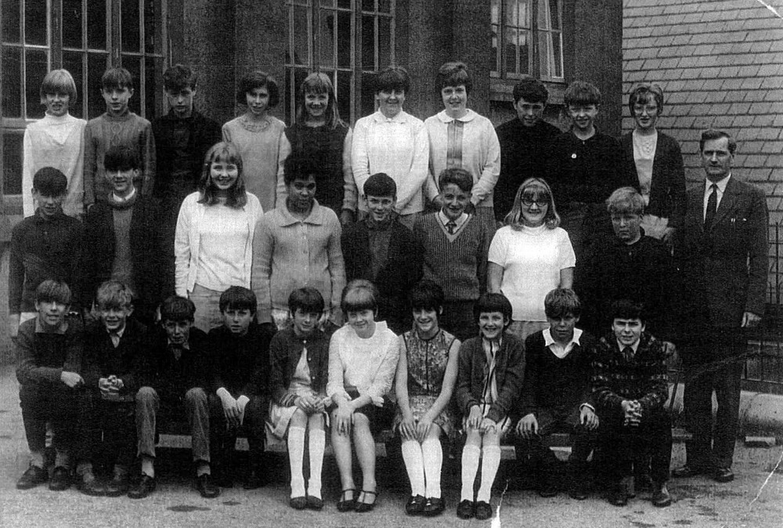
Modern school
Secondary Modern school did not prepare students for universities.

Slide 11
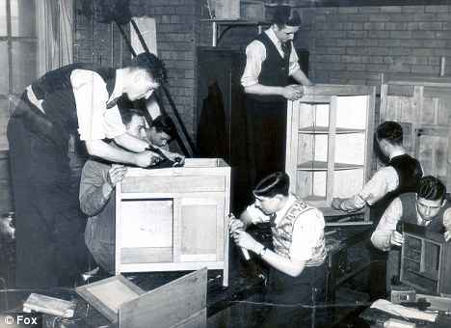
Technical school
Technical schools are for students, who want to do practical jobs, for example, welding, cooking.

Slide 12
1st form
2nd form
3rd form
4th form
5th form
General Certificate of Secondary Education
Further Education College
6th form

Slide 13
education in usa
Primary education
Secondary education
College
Elementary school
High school

Slide 14
6 7 8 9 10 11 12 13 14 15 16 17
Elementary school
High school
Reading
Physical education
Social studies
-Wide range of subjects
-Teenagers can choose a course of studies
Art
Mathematics
Grammar
computer
Music
Literature
Science

Slide 15
Education in russia
7
8
9
10
11
12
13
14
15
16
17
Primary school
S
E
C
O
N
D
A
R
Y
S
C
H
O
O
L
Intermediate course
Optional course

Slide 16
Secondary education in russia
Vocational or technical schools
Stay at school for 2 years
Intermediate course

