Slide 1
The education system in Great Britain
Tsyrenzhapova Sarana

Slide 2
content
What is the purpose of education?
Educational levels
Schools
Lessons
Exams
Technical schools
Conclusion

Slide 3
the education system in the UK and U.S.A
education system embrace 2 purposes:
it gives a general education to all children;
select the most advanced education.

Slide 4
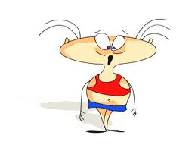
the education system in Russia
education system in Russian embrace only 1 purpose: it gives a general education to all children

Slide 5
3 stages of education in the UK
further education
secondary education
From 16
from 11 years of age to 16 years of age
primary or elementary education
from 5 years of age to 11 years of age

Slide 6
the education system in Russia
the education system in the U.S.A
primary education
secondary education
primary education
aged 7 to 11
aged 11 to 17
for 4 years
secondary education
age 6 to 14
for 8 years

Slide 7
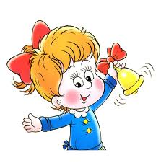
the education system in the U.S.A
secondary education
(high school)
For 4 years
primary education
(elementary school)
age 6 to 14
for 8 years

Slide 8
primary education
in the UK
infant school
junior school
aged 5 to 7
aged 7 to 11

Slide 9
secondary education
grammar school
technical school
modern school
comprehensive school

Slide 10
the education system in Russian
Sunday school
Older school
Younger school
For years
age 15 to 17
age 7 to 15

Slide 11
primary education
secondary education
children learn to read, write, count, draw.
first stage
second one stage

Slide 12
In the U.S.A in high school they may choose to study
the English language
advanced mathematics
literature
economics
history
chemistry
physics
geography
they can also learn such subjects as accounting or typing or shorthand of other subjects which will help them later when they enter the business

Slide 13
in the UK a comprehensive school gives the following range of subjects from which children can choose
English
Latin
Art
Music
Woodwork
French
German
Geography
Needlework
Mathematics
History
Metalwork
General science
Commercial subjects
Religious instruction
Physical education

Slide 14
in Russia pupils get a basic knowledge in the
Mathematics
Russian language
physics
foreign language
chemistry
Geography
Biology
History
Music
Art
Handicrafts

Slide 15
exam in the UK, Russia and the U.S.A
at the age of 14 or 15 in the third or fourth from of secondary school pupils begin to choose their exam subjects and prepare for their exam

Slide 16
technical schools
on completing the first stage course of studies pupils may either go to vocational or technical schools which give a profession training or stay on at the second stage for another 2 years

Slide 17
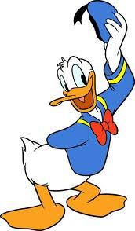
professions
Stylist
Stewardess
Cook
Tailor
Seller
Masseur
Educator
Mechanic

Slide 18
Conclusion
stages of education in the UK, U.S.A and Russia
primary or elementary education
secondary education

Slide 19
the end

